Slide 1
Waste and Overuse
Impact on Healthcare Industry Sustainability
Dr. Ali Anees

Slide 2



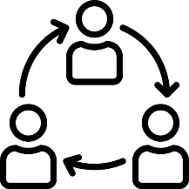

Waste and Overuse | Overview
A global challenge to the healthcare industry
Healthcare industry growth in UAE is a successful journey
Collaboration between the providers and payers is highly supported by regulators
Structured and standardized billing schemas, that are highly codified
3-10%
Waste and Overuse is an anomaly of the healthcare industry
US estimated waste and overuse of the healthcare spending according to the 2011 FBI Journal

Slide 3









Waste and Overuse | Framework and Governance
Daman heavily invested into resources and systems to detect fraud waste and abuse to protect the funds of its members
Obligation to protect members fund and healthcare quality
Control measure to reduce unnecessary healthcare expenditure
Specialized team with medical, coding, analytical, and audit expertise
Availability of whistleblowing platforms internally and externally
Helpline to anonymously report any suspicions of waste and overuse
National media campaign to raise awareness
Referral to the appropriate regulatory authority and delisting from network
Criminal prosecution
and civil recovery

Slide 4




Waste and Overuse | Audit Statistics
Focused and stratified sample of paid claims
Health insurance misuse and abuse is inherit in every health insurance system. Vulnerabilities or major audit findings are tracked for purposes of developing and monitoring corrective measures.
>3,000 providers
>6,000 audit visits
>2 million claims/medical record
>100 suspected fraud cases reported to the regulator

Slide 5
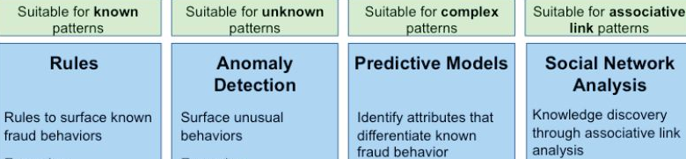
Waste and Overuse | Big Data Analytics
Patterns & behaviors
The use of data mining tools and predictive analytic technology is becoming more and more essential to identify suspicious billing patterns.
Variety of methods are used to detect misuse and abuse schemes
    Data mining tools
    Social network analysis
    Predictive modeling

Slide 6




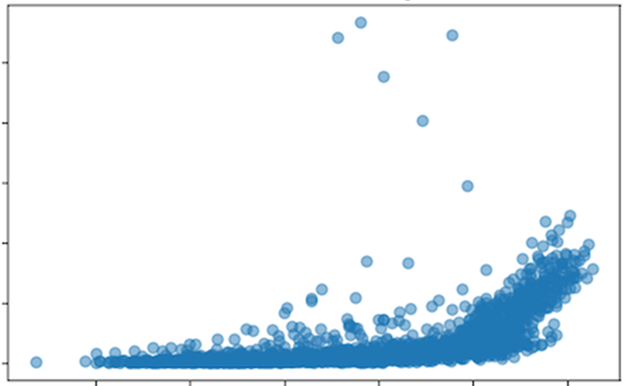
Waste and Overuse | Focused Behavioral Interventions
Daman’s know-how in tackling outliers
Trend Analysis and Focused Behavioural Interventions
Fair local benchmarking and peer reviews
Standardized and codified claims data support big data analytics
Excessive behaviour lies above a set percentile threshold of the local market
Positive shift towards improvement in the utilisation behaviour

Slide 7
Waste and Overuse | Intervention Outcomes
Laboratory Spending 2015 - 2017
AED
Intervention #1
Intervention #2
Intervention #3
Intervention #4
Jan
Feb
Mar
Apr
May
Jun
Jul
Aug
Sep
Oct
Nov
Dec
Jan
Feb
Mar
Apr
May
Jun
Jul
Aug
Sep
Oct
Nov
Dec
Jan
Feb
Mar
Apr
May
2015
2016
2017

Slide 8
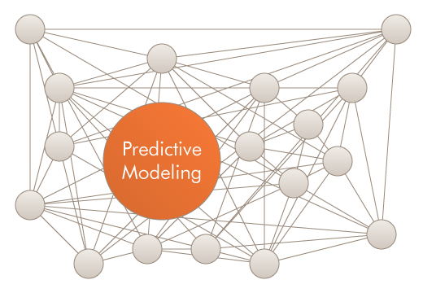

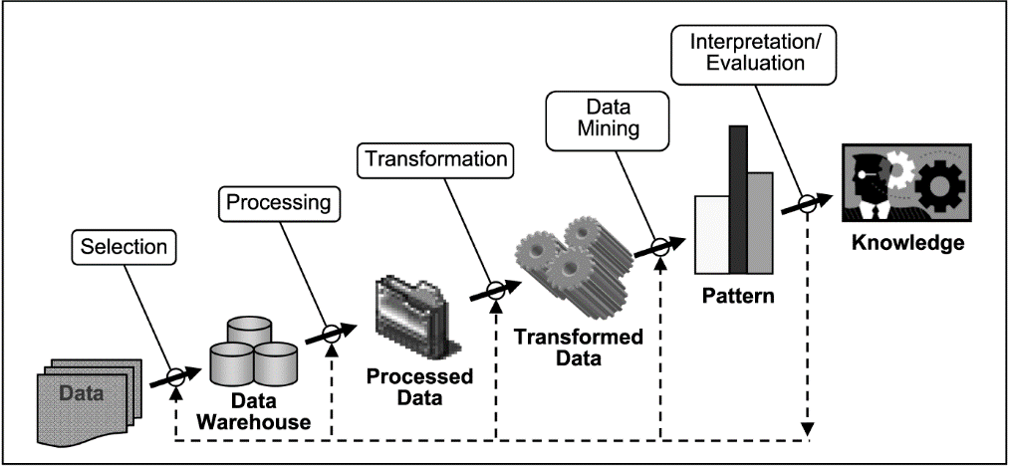




Waste and Overuse | Our Responsibility
All stakeholders across the healthcare industry have a responsibility to ensure sustainability of the industry and need to work collaboratively to fight and prevent waste, fraud, and abuse
Focused Behavioural Interventions based on clinicians and members behaviour is more effective and efficient in comparison to a claim to claim review which has proven to be less effective
Artificial Intelligence
Big Data
Predictive Modeling
Trend Analysis

Slide 9
شـكـراً جـزيـلاً
Thank you

